Slide 1
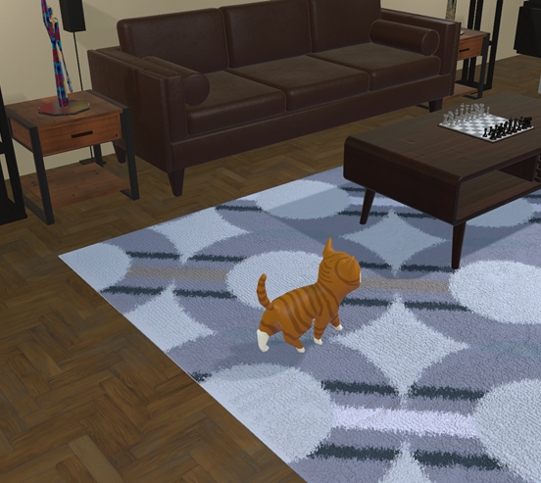
Naughty Cat Team Scorpio
Linn L Bergerfelt
Kiran Shehzadi​​

Slide 2
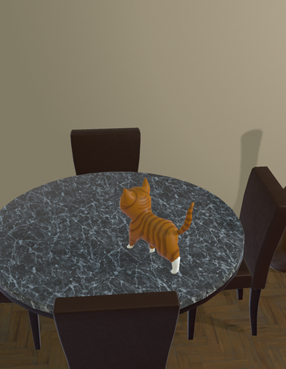
Functionality and UI:
Eat 10 good food items
Avoid bad food
3 lives
Timed Game
There’s background music to enhance the gameplay, also sound effects have been added for eating good food and bad food.
Particle effects have also been added for when the cat eats different foods.

Slide 3
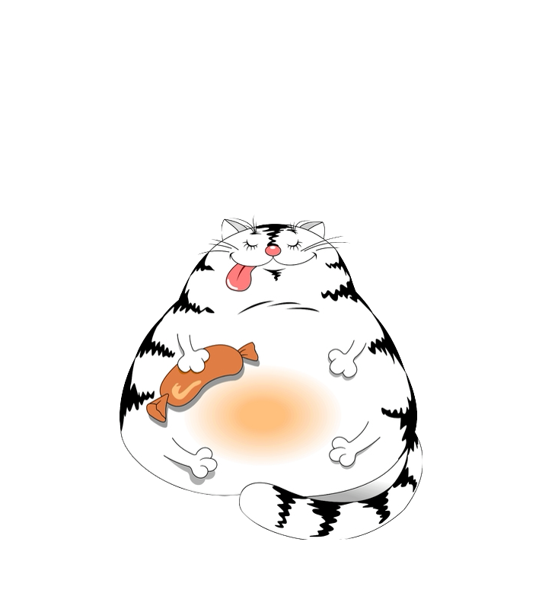
Challenges
No c# Experience
Finding Good Assets
Third Person View
Making Animations
Spawning Food (Random)
Locations for Food Spawning( Random)
Business

Slide 4
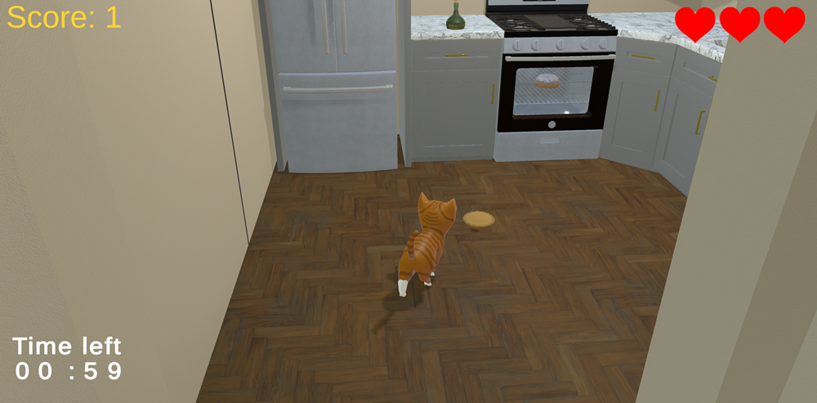
Compromises
No Start or End screen
No Jump/ eating/ faint Animations
No restart Button
The cat can’t Move stuff but can open doors

Slide 5
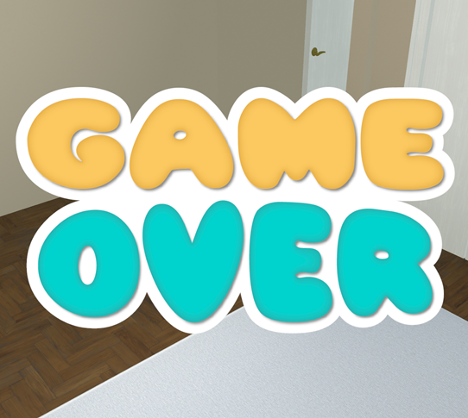
Thank You
Than

